Slide 1
Edge Detection
Objective: To perform wavelet based edge detection using scale multiplication
Karthick M - cb.en.u4ece21121
Ovya S J - cb.en.u4ece21134
G.R.Prakalya - cb.en.u4cce21018
Rishikumar K - cb.en.u4cce21053

Slide 2
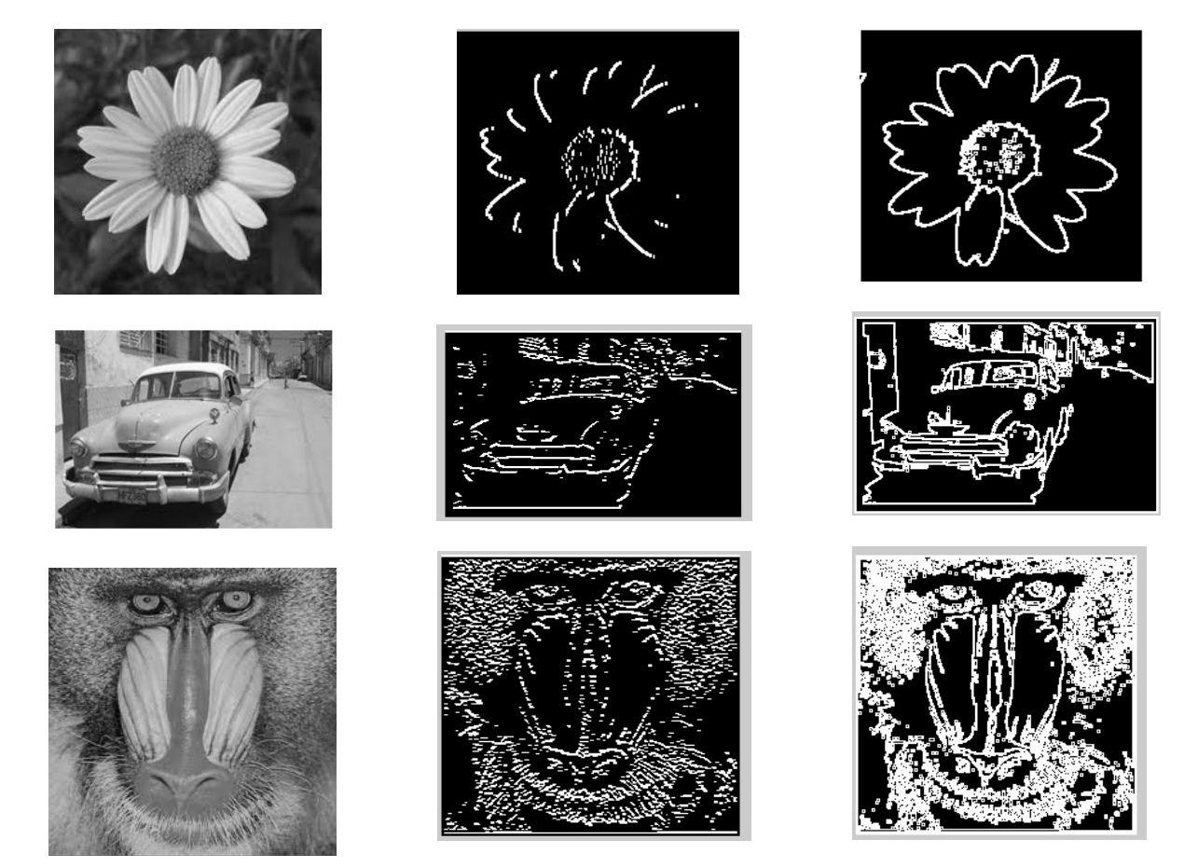
Edge detection
To seperate boundaries of one region from another.

Slide 3
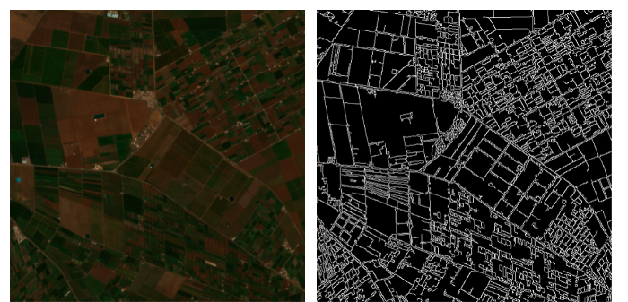

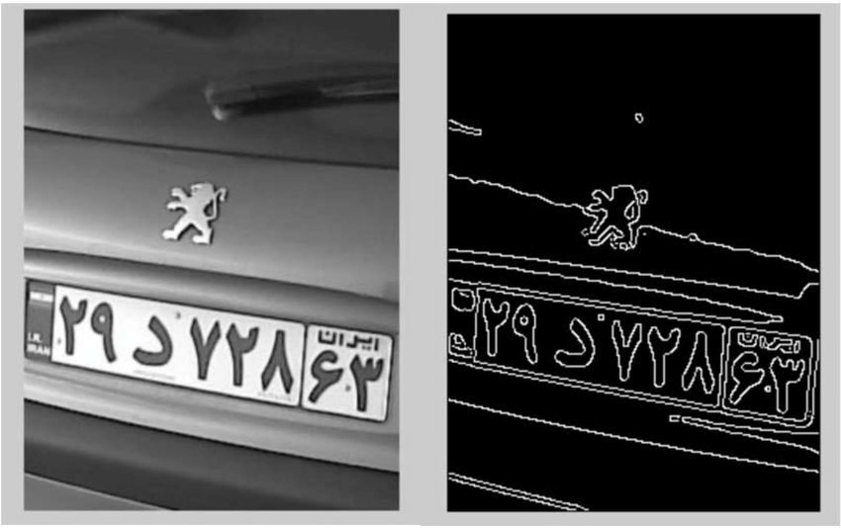
Applications
Fingerprint recognition
Edge map for satellite images
License plate detection
Medical diagnosis
In self driving cars

Slide 4
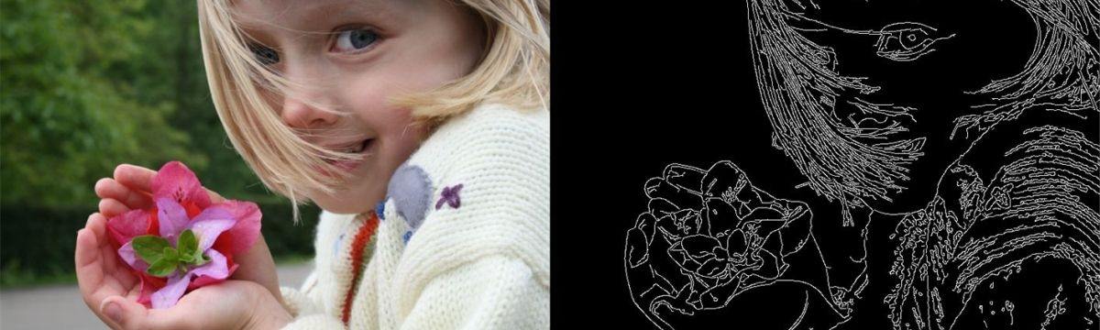
Features extracted
Discontinuties.
Contours.
Direction and magnitude of edges.

Slide 5
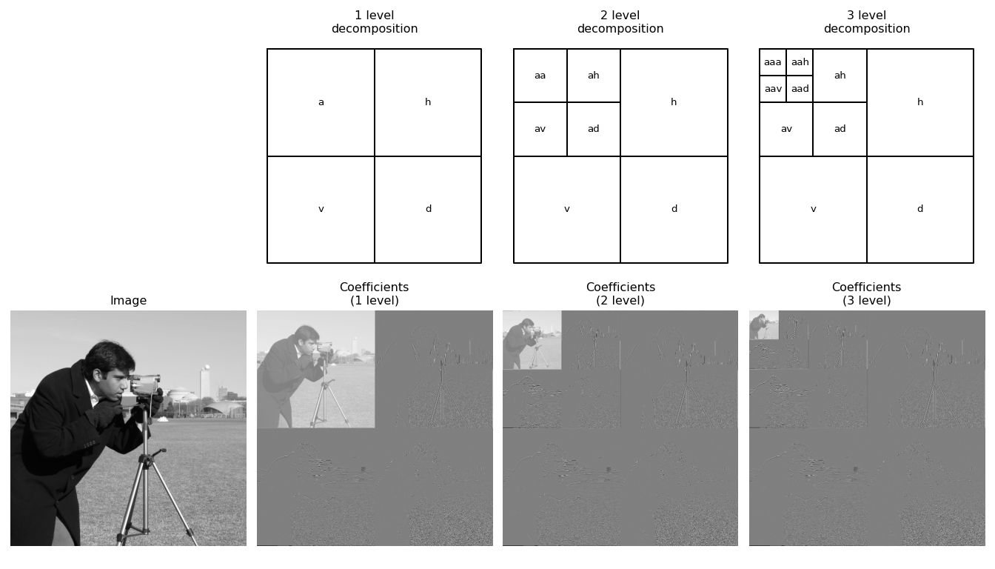
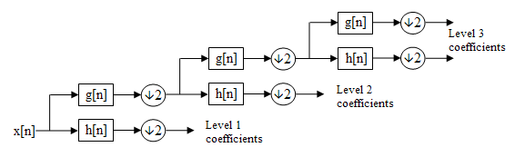
Process
Wavelet decomposition:
Implementing on both original and scaled image.

Slide 6
Process
Scale Multiplication:
Multiplying horizontal of original with horizontal of scaled image.
Likewise for the vertical components.
Edge map:
Taking the square root of horizontal and vertical components.

Slide 7

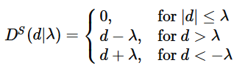
Process
Thresholding:
Hard
Soft:

Slide 8
Choice of wavelets
Haar – chosen
Efficient decomposition
Supports multiresolution analysis
Detects sharp transitions
No duplication of information

Slide 9
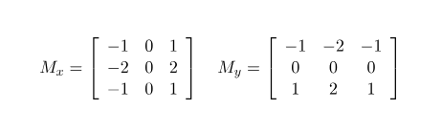
Other techniques
Sobel Edge Detection:
Discrete differentiation operator.
Advantages:
Simple and time efficient computation
Very easy at searching for smooth edges
Limitations:
Not very accurate in edge detection
Detect with thick and rough edges does not give appropriate results

Slide 10

Other techniques
Prewitt Operator:
Advantages:
Good performance on detecting vertical and horizontal edges
Best operator to detect the orientation of an image
Limitations:
The magnitude of coefficient is fixed and cannot be changed
Diagonal direction points are not preserved always

Slide 11

Other techniques
Robert Operator:
Advantages:
Detection of edges and orientation are very easy
Diagonal direction points are preserved
Limitations:
Very sensitive to noise
Not very accurate in edge detection

Slide 12
Other techniques
Canny Operator:
Detects edges based on three criteria:
Low error rate.
Edge points must be accurately localized.
There should be just one single edge response.
Advantages:
It has good localization.
It extract image features without altering the features.
Less Sensitive to noise.

Slide 13


